Slide 1


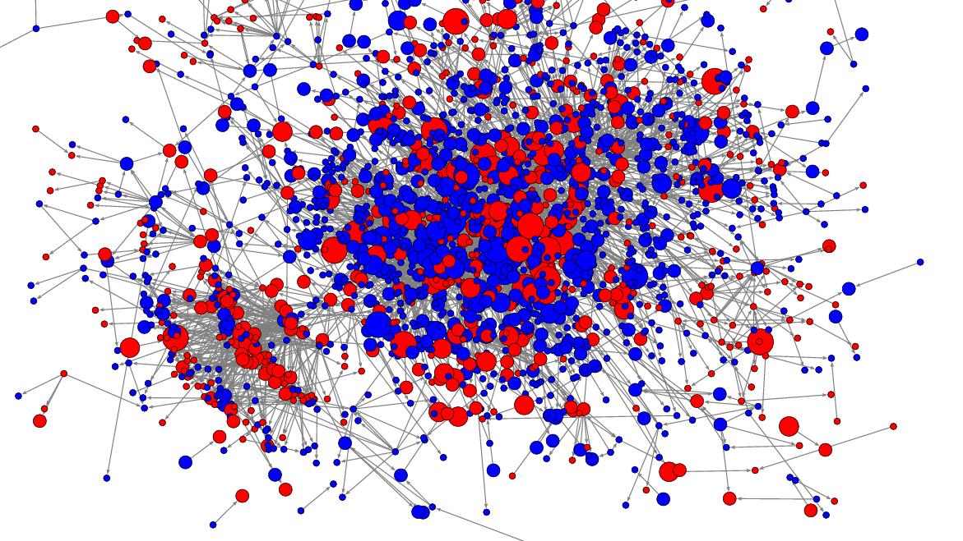
Data mining
Final project
Itay Hatzuel
Ronen Benyaminov
MAi BEN AMI

Slide 2
intro
Our goal: show a followers network, gathered dynamically , starting from a given user.
For each follower, we collect ‘x’ followers, and it goes on and on until we hit the API’s rate limit (60 requests per 15 minutes). After generating a graph, we will analyze it.

Slide 3
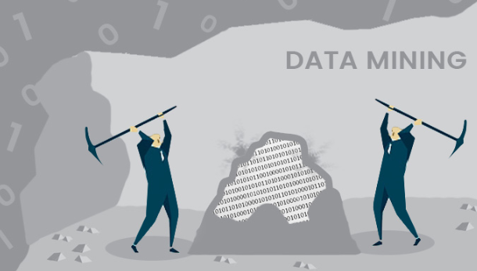
Collecting the data
We used “Tweepy” library to access the Twitter API.
With Twitter API you can:
Search , Find followers, Post and more.
We created a new Twitter App through Twitter Developer site, in order go get our access tokens for the API.
Collecting Algorithm works as follows;
Build Graph
Collect all Followers
Collect all Followers of Followers and so on..
Limit is ‘x’ followers for each user.

Slide 4
Analyzing graph
We chose to analyze a few properties:
Centrality
Bridges
Degree Histogram

Slide 5
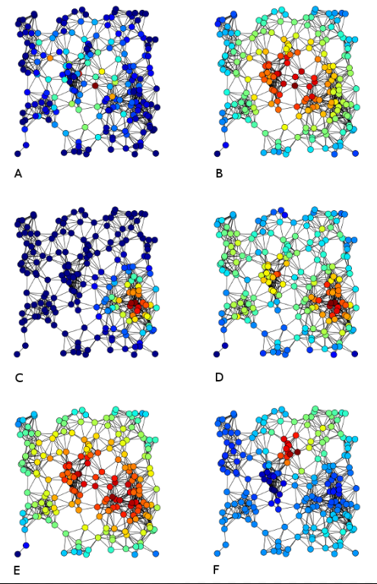
Centrality
In graph theory , indicators of centrality identify the most important vertices within a graph.
Applications include identifying the most influential person(s) in a social network.

Slide 6
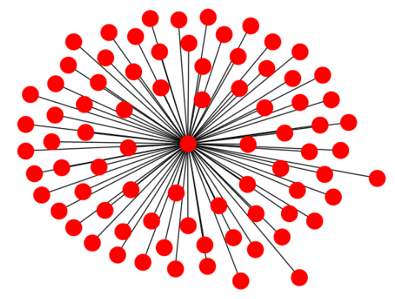
CENTRALITY
Types of centrality include : Closeness centrality , Betweenness centrality , Harmonic centrality and more.
We chose to focus on Eigenvector centrality.

Slide 7
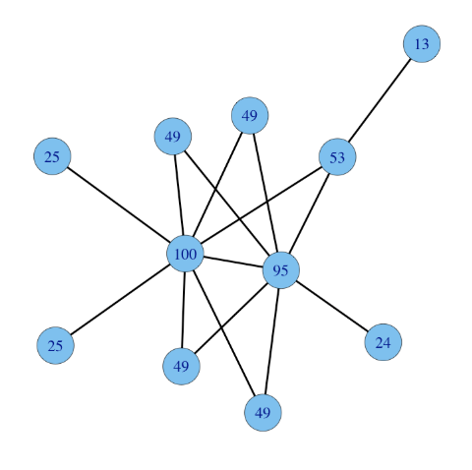
Eigenvector centrality
Eigenvector Centrality is a measure of the influence of a node in a network.
Relative scores are assigned to all nodes in the network. A high eigenvector score means that a node is connected to many nodes who themselves have high scores (Google PageRank algorithm is based off that idea).
The higher the score, the more influential the person is.
We check centrality for each node, and log it to a CSV file.
Then, print the user with the highest score.

Slide 8
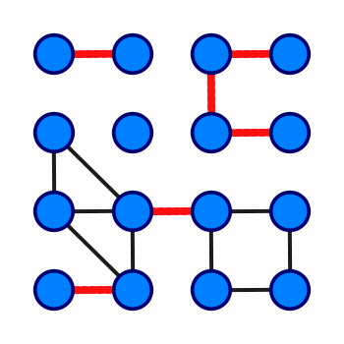
Bridge
A bridge is an edge of a graph whose deletion increases its number of connected components.
In our program, we first checked for bridges,
- If none do nothing.
- else, save the bridges to a text file.

Slide 9
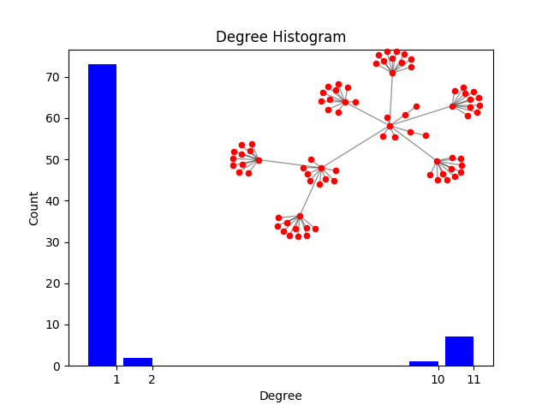
Degree histogram
A histogram is an accurate representation of the distribution of numerical data.
We chose to represent the degree for each node with the histogram tool by pyplot.

Slide 10


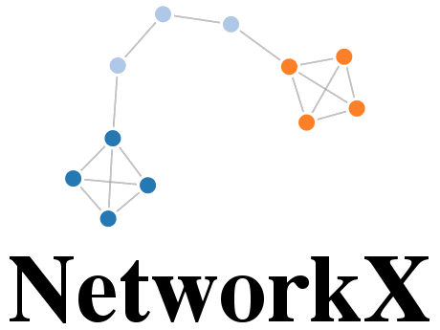
Tools used
https://github.com/rouih/DMprojectfinal.git
Python 2.7
PyPlot by Matplotlib, NetworkX
Git: https://github.com/rouih/DMprojectfinal.git

Slide 11
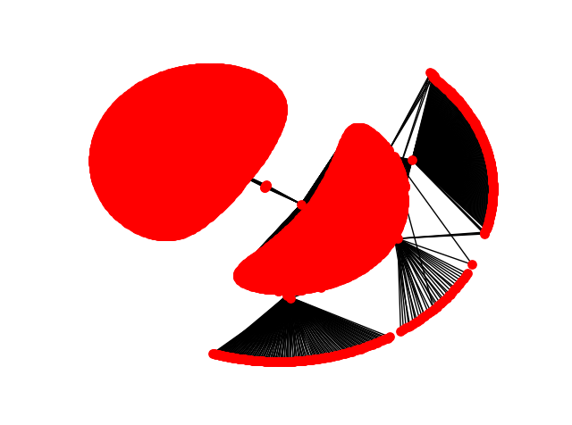
Thank you!

Slide 12
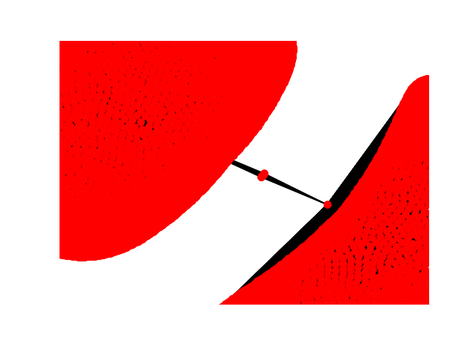
Thank you!

Slide 13
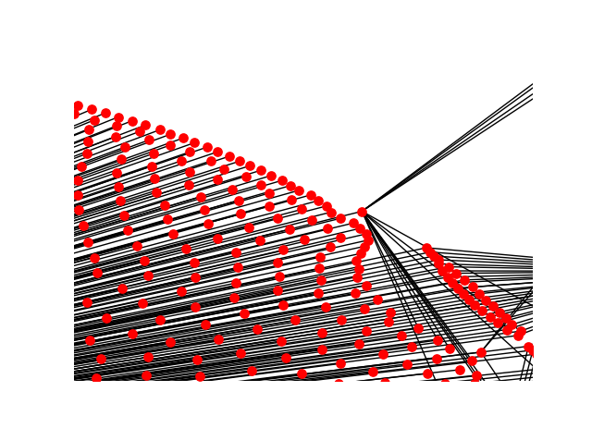
Thank you!

Slide 14
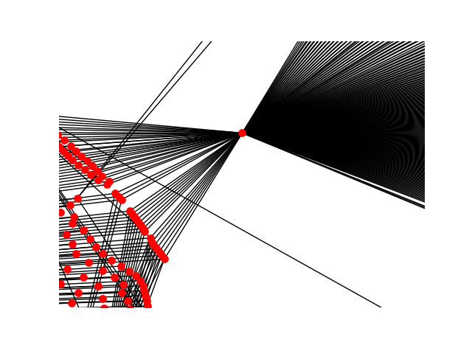
Thank you!

Slide 15
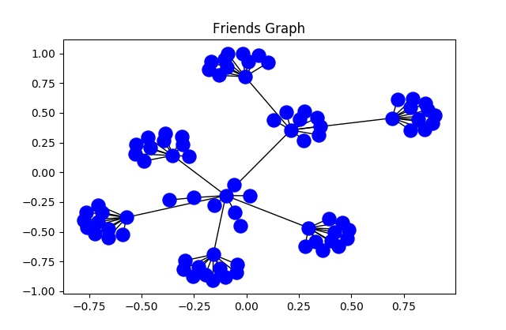
Thank you!

